Slide 1
PRESENTATION ON SHALLOW COPY AND DEEP COPY IN JAVASCRIPT Presented by :- Omkar Narendra Patil
WELCOME

Slide 2
OUTLINES:
Introduction to Copying in JavaScript.
Shallow Copy.
Shallow Copy in Action
Deep Copy
Deep Copy in Action
Conclusion.

Slide 3
Introduction to Copying in JavaScript:
Definition of copying in JavaScript: Copying involves creating a new object or array with the same values as the original. However, the way this duplication is achieved can have significant implications for how changes to the copied data affect the original.
Importance of understanding shallow and deep copy: Shallow copy and deep copy are two common approaches to copying in JavaScript, each with its own advantages and use cases. Choosing the appropriate method depends on the structure and complexity of the data being copied.

Slide 4
Shallow Copy:
Definition of shallow copy: Shallow copy creates a new object or array and copies only the top-level properties or elements of the original. Nested objects or arrays are copied by reference, not value.
Explanation of how shallow copy works: Shallow copying duplicates the immediate properties or elements of the original object or array. However, if these properties or elements contain nested objects or arrays, only references to them are copied, resulting in a shallow relationship between the original and copied data.

Slide 5
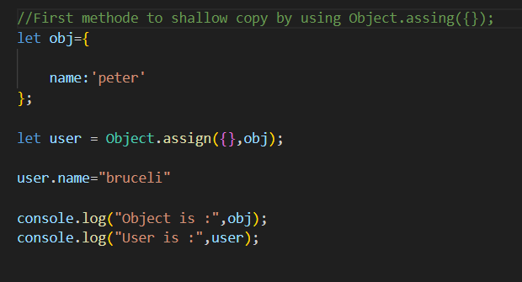
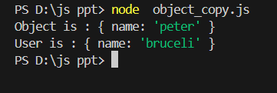
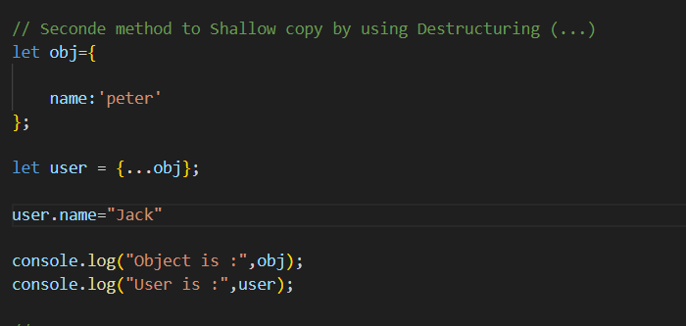
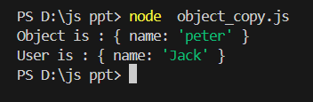
Shallow Copy in Action:
Output:-
Output:-

Slide 6
Deep Copy:
Definition of deep copy: Deep copy involves recursively copying all properties or elements of an object or array, including nested objects or arrays, to create a completely independent duplicate.
Example code demonstrating deep copy: Achieving deep copy in JavaScript often requires custom implementations, as built-in methods like Object.assign() and spread syntax (...) only perform shallow copy. Recursive functions or libraries like Lodash can be used to deep copy complex data structures.
Explanation of how deep copy works: Deep copy traverses through the entire data structure, creating new objects or arrays for each nested level. This ensures that every piece of data is duplicated, eliminating any shared references between the original and copied data.

Slide 7
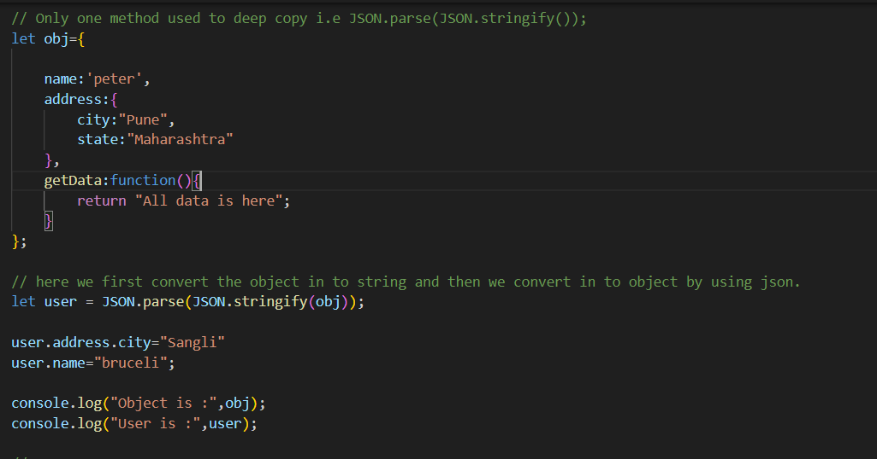
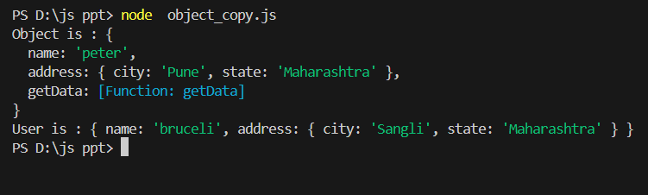
Deep Copy in Action:
Output:-

Slide 8
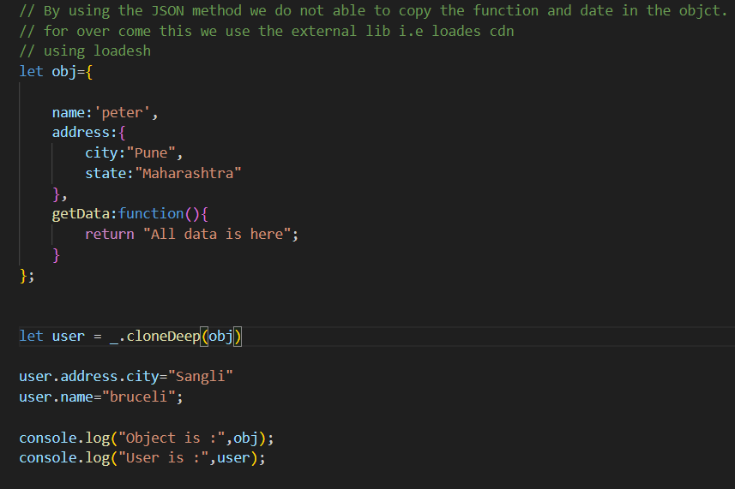
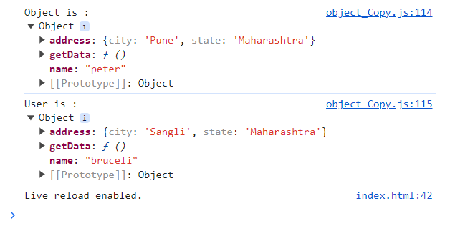
Deep Copy in Action:
Output:-

Slide 9
Conclusion:
Recap of key points: Shallow copy creates a new object or array with only the top-level properties or elements copied, while deep copy creates a completely independent duplicate, including all nested objects or arrays.
In conclusion, understanding the concepts of shallow copy and deep copy in JavaScript is crucial for effective data management and manipulation.
By mastering shallow copy and deep copy in JavaScript, you'll be better equipped to handle complex data structures and ensure data integrity throughout your applications. Keep exploring, experimenting, and applying these concepts in your development endeavors.

Slide 10
THANK YOU

